Slide 1
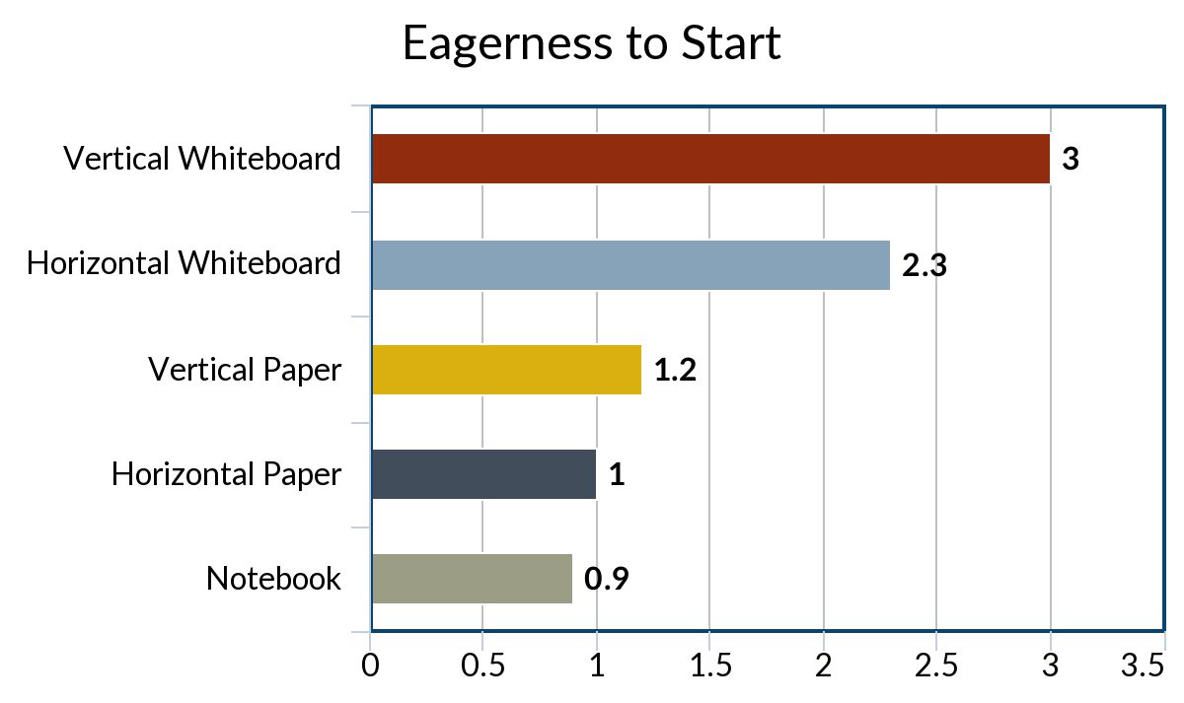
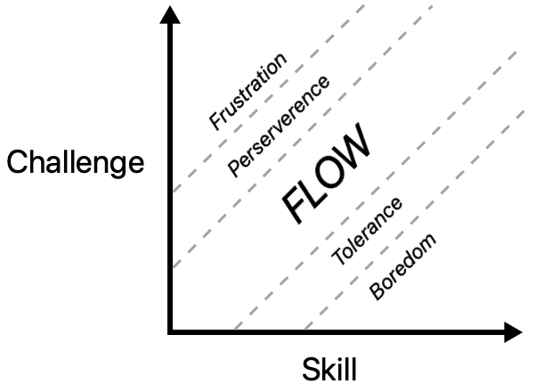
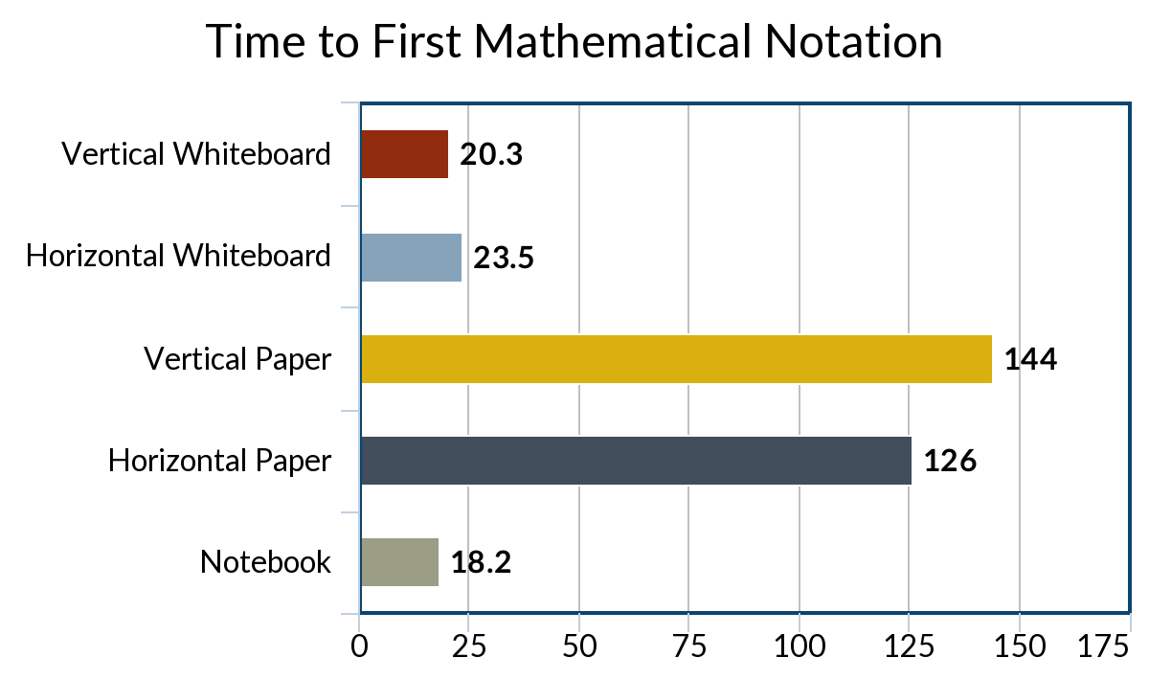
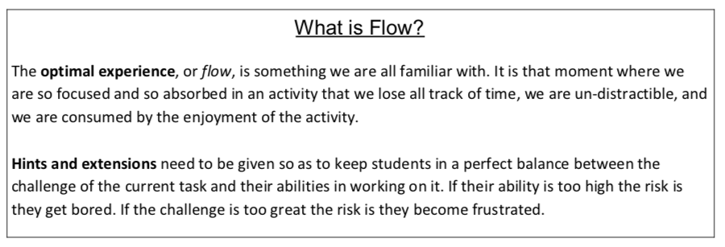
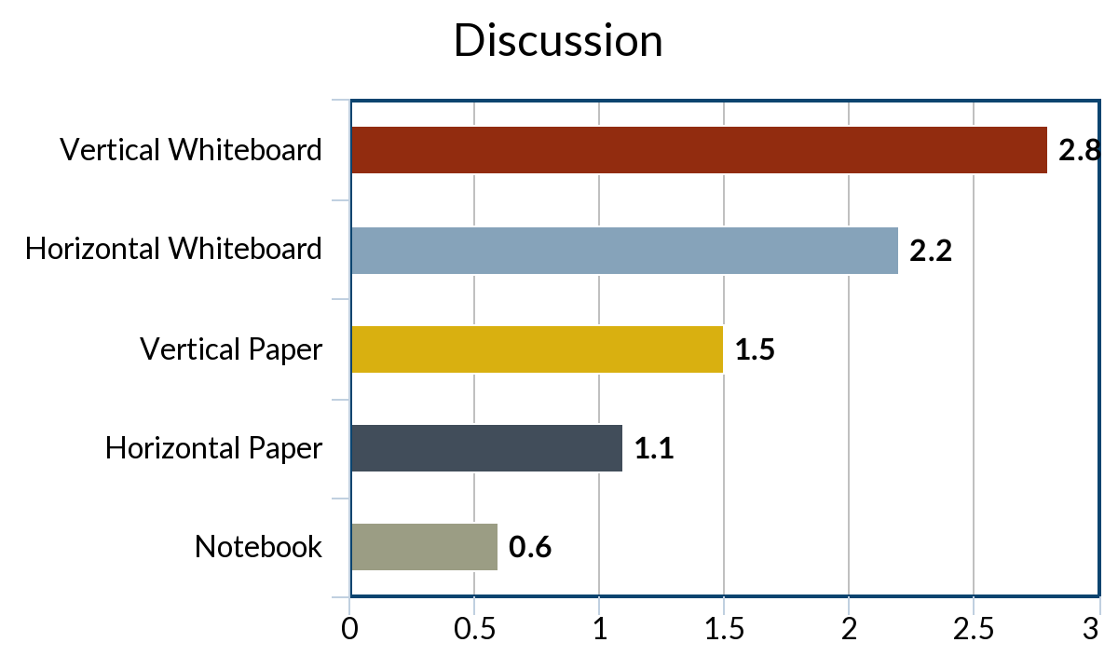
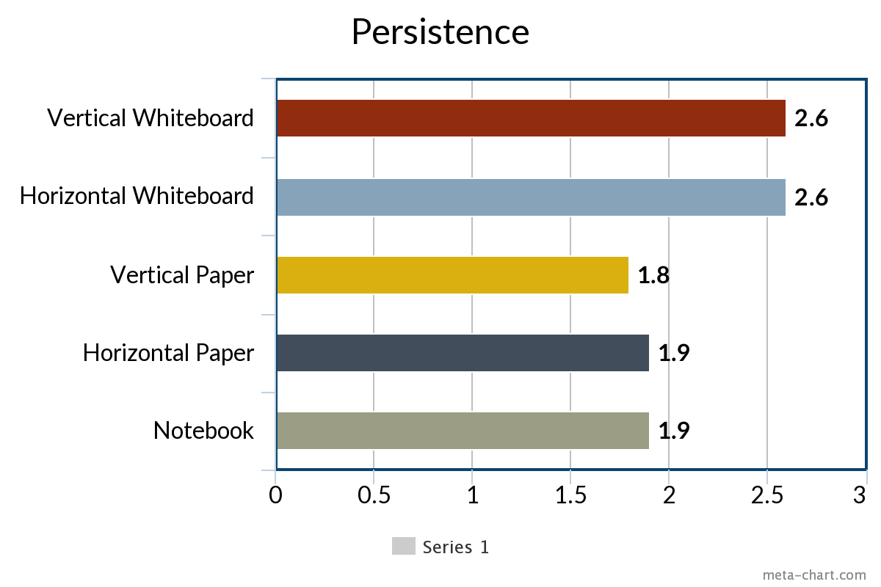
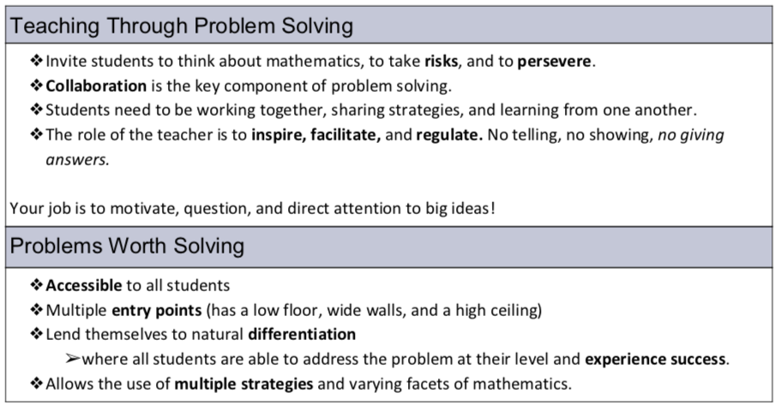
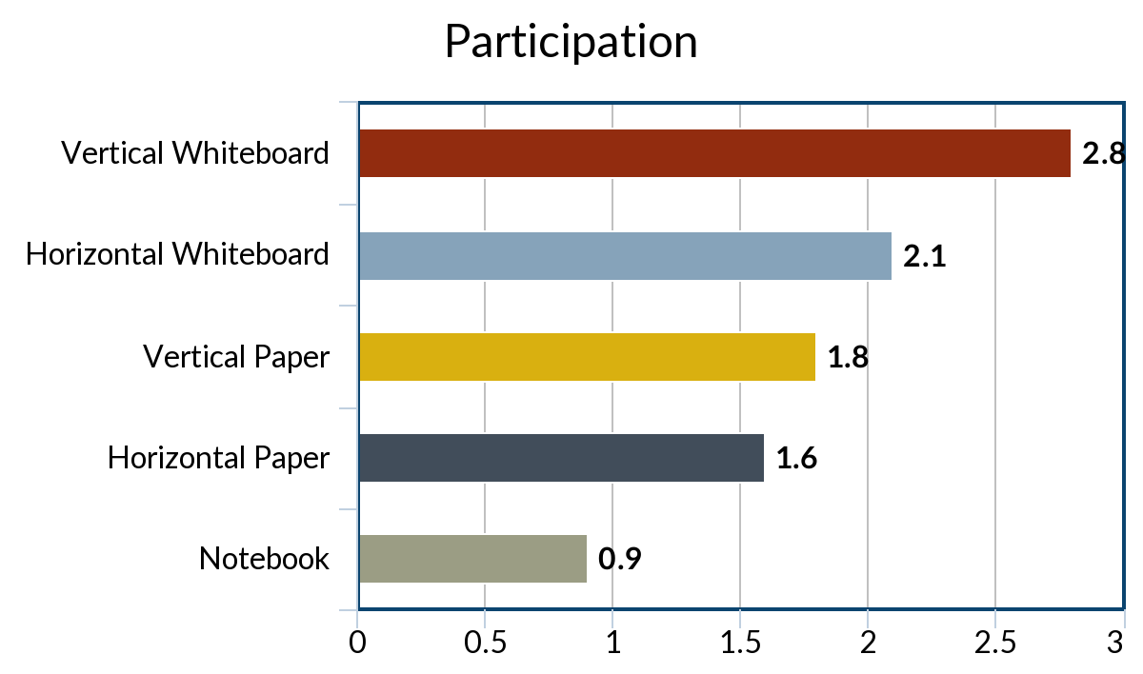
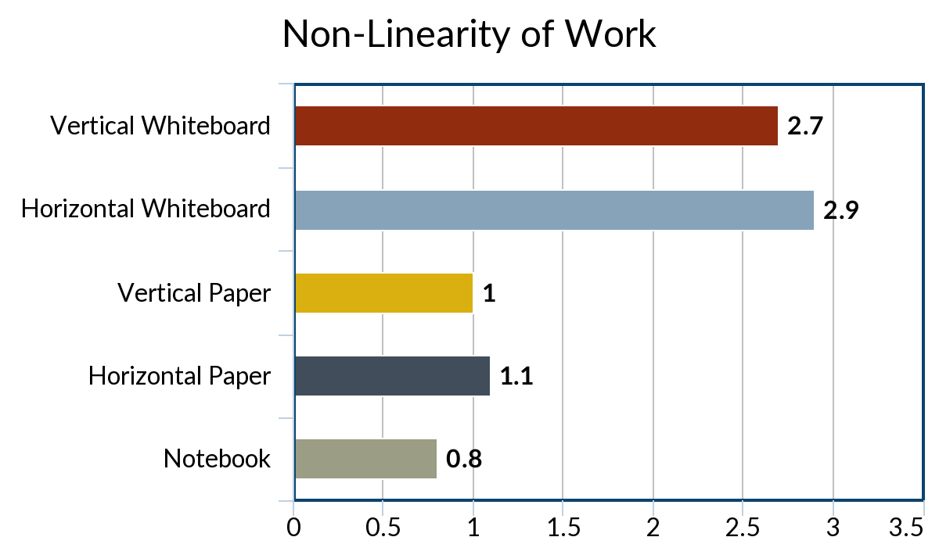
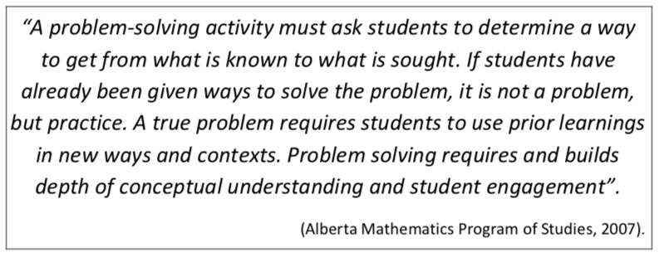
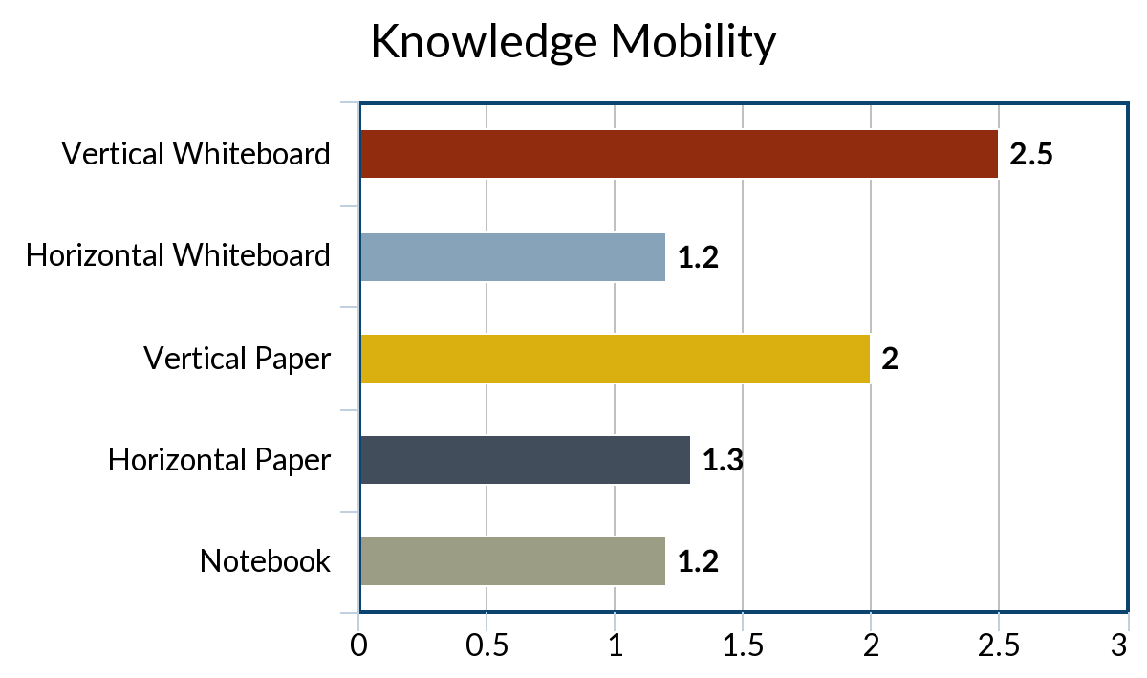
How can I
manipulate the traditional
classroom to encourage
engagement in math?
How can I
Stimulate deep
thinking?
WHY VERTICAL
NON-PERMANENT
SURFACES?
Building
Thinking
Classrooms
Use Vertical
Non-Permanent
Surfaces
Form
Visibly
Random
Groups
Begin
with Good
Problems
De-front the
Classroom
Use Oral
Instructions
Answer only
“Keep Thinking”
Questions
Use
Mindful
Notes
Build
Autonomy
Use
Hints and
Extensions
Check for
Understanding
Level
to the
Bottom
Shift
Assessment
Problems
Worth
Solving

Slide 2
How can I
manipulate the traditional
classroom to encourage
engagement in math?
How can I
Stimulate deep
thinking?
Kelly Wallace

Slide 3
How can I
manipulate the traditional
classroom to encourage
engagement in math?
How can I
Stimulate deep
thinking?
WHY VERTICAL
NON-PERMANENT
SURFACES?
Building
Thinking
Classrooms
Use Vertical
Non-Permanent
Surfaces
Form
Visibly
Random
Groups
Begin
with Good
Problems
De-front the
Classroom
Use Oral
Instructions
Answer only
“Keep Thinking”
Questions
Use
Mindful
Notes
Build
Autonomy
Use
Hints and
Extensions
Check for
Understanding
Level
to the
Bottom
Shift
Assessment
Problems
Worth
Solving

Slide 5
How can I
manipulate the traditional
classroom to encourage
engagement in math?
How can I
Stimulate deep
thinking?
WHY VERTICAL
NON-PERMANENT
SURFACES?
Building
Thinking
Classrooms
Use Vertical
Non-Permanent
Surfaces
Form
Visibly
Random
Groups
Begin
with Good
Problems
De-front the
Classroom
Use Oral
Instructions
Answer only
“Keep Thinking”
Questions
Use
Mindful
Notes
Build
Autonomy
Use
Hints and
Extensions
Check for
Understanding
Level
to the
Bottom
Shift
Assessment
Problems
Worth
Solving

Slide 6
I was curious as to how a teacher
could actively measure
engagement in the classroom.
This lead me to the idea of flow.

Slide 7
How can I
manipulate the traditional
classroom to encourage
engagement in math?
How can I
Stimulate deep
thinking?
WHY VERTICAL
NON-PERMANENT
SURFACES?
Building
Thinking
Classrooms
Use Vertical
Non-Permanent
Surfaces
Form
Visibly
Random
Groups
Begin
with Good
Problems
De-front the
Classroom
Use Oral
Instructions
Answer only
“Keep Thinking”
Questions
Use
Mindful
Notes
Build
Autonomy
Use
Hints and
Extensions
Check for
Understanding
Level
to the
Bottom
Shift
Assessment
Problems
Worth
Solving

Slide 8
What is Flow?
The optimal experience , or flow, is
something we are all familiar with.
It is that moment where
we are so focused and
so absorbed in an activity
that we lose all track of time,
we are un-distractible,
and we are consumed by the
enjoyment of the activity.
Hints and extensions need to be given so as to keep students in a perfect balance between the challenge of the current task and their abilities in working on it. If their ability is too high the risk is they get bored. If the challenge is too great the risk is they become frustrated.

Slide 9
How can I
manipulate the traditional
classroom to encourage
engagement in math?
How can I
Stimulate deep
thinking?
WHY VERTICAL
NON-PERMANENT
SURFACES?
Building
Thinking
Classrooms
Use Vertical
Non-Permanent
Surfaces
Form
Visibly
Random
Groups
Begin
with Good
Problems
De-front the
Classroom
Use Oral
Instructions
Answer only
“Keep Thinking”
Questions
Use
Mindful
Notes
Build
Autonomy
Use
Hints and
Extensions
Check for
Understanding
Level
to the
Bottom
Shift
Assessment
Problems
Worth
Solving

Slide 11
How can I
manipulate the traditional
classroom to encourage
engagement in math?
How can I
Stimulate deep
thinking?
WHY VERTICAL
NON-PERMANENT
SURFACES?
Building
Thinking
Classrooms
Use Vertical
Non-Permanent
Surfaces
Form
Visibly
Random
Groups
Begin
with Good
Problems
De-front the
Classroom
Use Oral
Instructions
Answer only
“Keep Thinking”
Questions
Use
Mindful
Notes
Build
Autonomy
Use
Hints and
Extensions
Check for
Understanding
Level
to the
Bottom
Shift
Assessment
Problems
Worth
Solving

Slide 13
How can I
manipulate the traditional
classroom to encourage
engagement in math?
How can I
Stimulate deep
thinking?
WHY VERTICAL
NON-PERMANENT
SURFACES?
Building
Thinking
Classrooms
Use Vertical
Non-Permanent
Surfaces
Form
Visibly
Random
Groups
Begin
with Good
Problems
De-front the
Classroom
Use Oral
Instructions
Answer only
“Keep Thinking”
Questions
Use
Mindful
Notes
Build
Autonomy
Use
Hints and
Extensions
Check for
Understanding
Level
to the
Bottom
Shift
Assessment
Problems
Worth
Solving

Slide 14
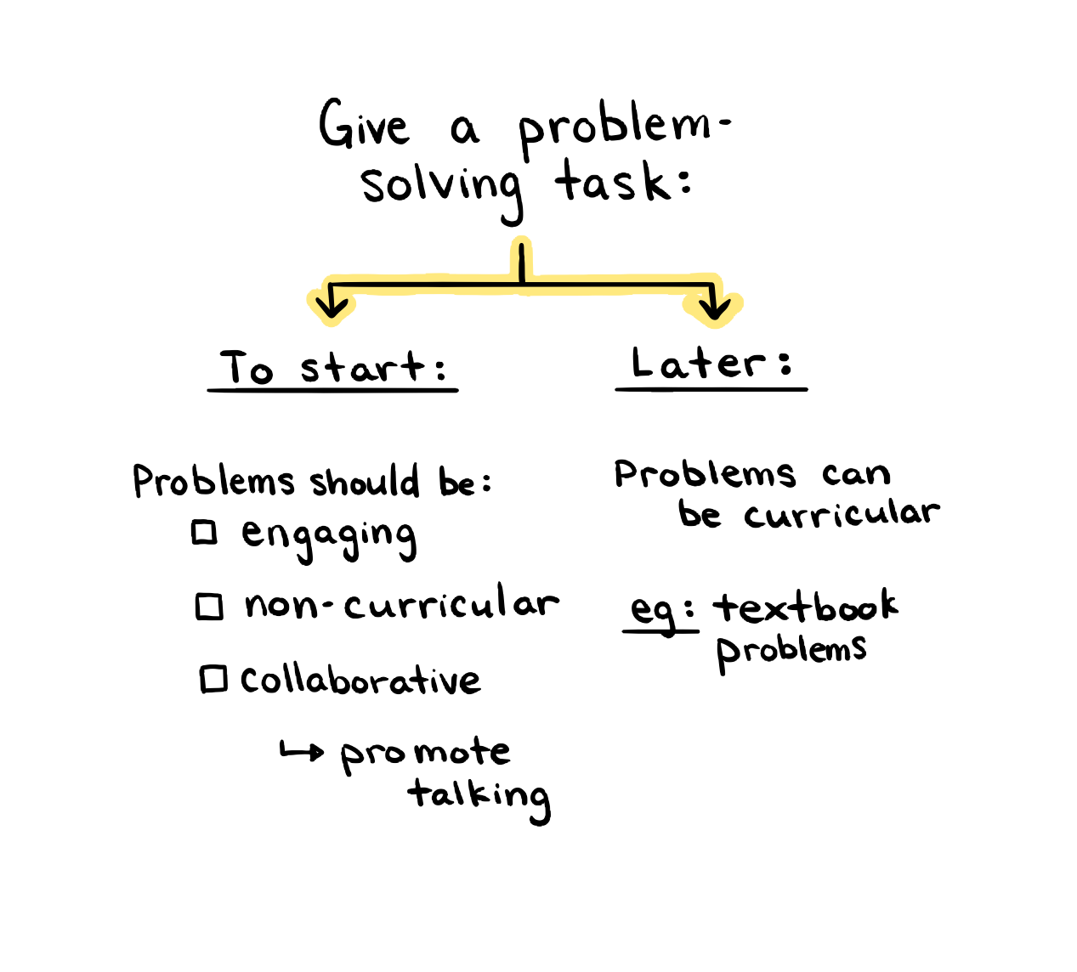
Begin
with Good
Problems

Slide 15
How can I
manipulate the traditional
classroom to encourage
engagement in math?
How can I
Stimulate deep
thinking?
WHY VERTICAL
NON-PERMANENT
SURFACES?
Building
Thinking
Classrooms
Use Vertical
Non-Permanent
Surfaces
Form
Visibly
Random
Groups
Begin
with Good
Problems
De-front the
Classroom
Use Oral
Instructions
Answer only
“Keep Thinking”
Questions
Use
Mindful
Notes
Build
Autonomy
Use
Hints and
Extensions
Check for
Understanding
Level
to the
Bottom
Shift
Assessment
Problems
Worth
Solving

Slide 16
Use
Vertical
Non
Permanent
Surfaces

Slide 17
How can I
manipulate the traditional
classroom to encourage
engagement in math?
How can I
Stimulate deep
thinking?
WHY VERTICAL
NON-PERMANENT
SURFACES?
Building
Thinking
Classrooms
Use Vertical
Non-Permanent
Surfaces
Form
Visibly
Random
Groups
Begin
with Good
Problems
De-front the
Classroom
Use Oral
Instructions
Answer only
“Keep Thinking”
Questions
Use
Mindful
Notes
Build
Autonomy
Use
Hints and
Extensions
Check for
Understanding
Level
to the
Bottom
Shift
Assessment
Problems
Worth
Solving

Slide 18
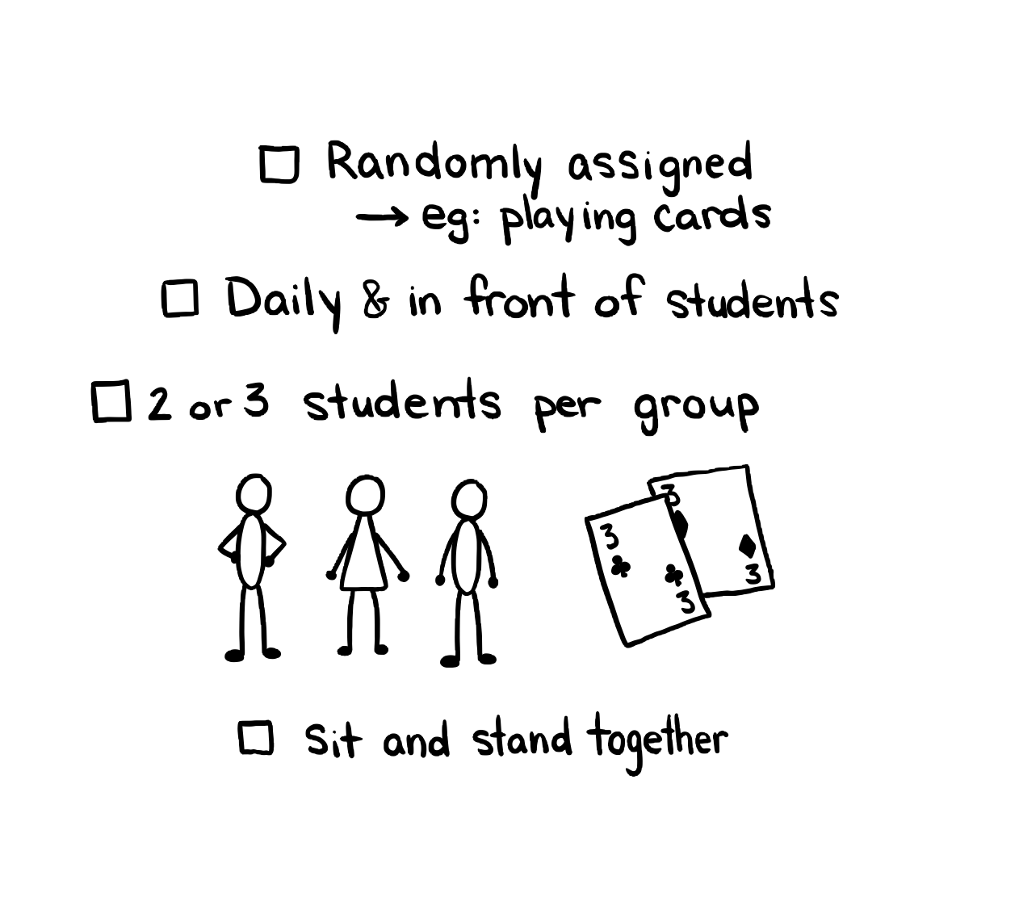
Form
Visibly
Random
Groups

Slide 19
How can I
manipulate the traditional
classroom to encourage
engagement in math?
How can I
Stimulate deep
thinking?
WHY VERTICAL
NON-PERMANENT
SURFACES?
Building
Thinking
Classrooms
Use Vertical
Non-Permanent
Surfaces
Form
Visibly
Random
Groups
Begin
with Good
Problems
De-front the
Classroom
Use Oral
Instructions
Answer only
“Keep Thinking”
Questions
Use
Mindful
Notes
Build
Autonomy
Use
Hints and
Extensions
Check for
Understanding
Level
to the
Bottom
Shift
Assessment
Problems
Worth
Solving

Slide 20
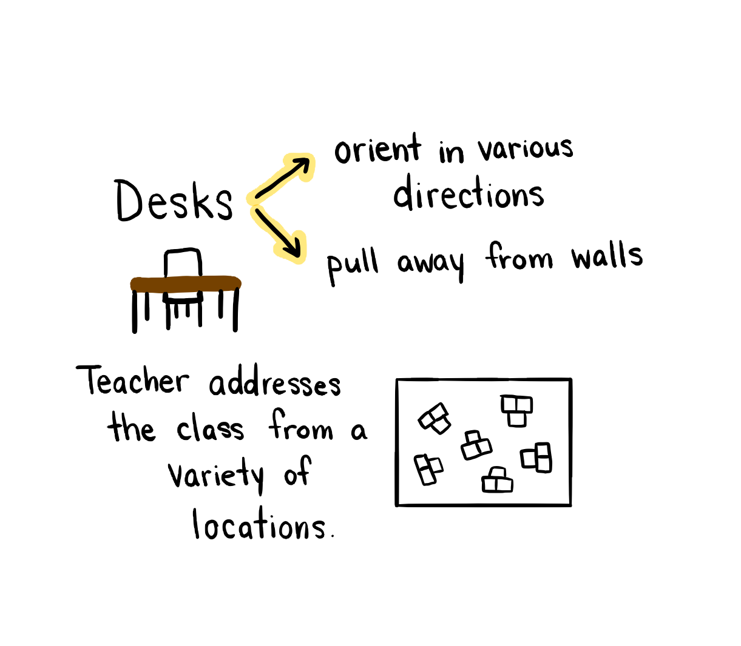
De-Front the
Classroom

Slide 21
How can I
manipulate the traditional
classroom to encourage
engagement in math?
How can I
Stimulate deep
thinking?
WHY VERTICAL
NON-PERMANENT
SURFACES?
Building
Thinking
Classrooms
Use Vertical
Non-Permanent
Surfaces
Form
Visibly
Random
Groups
Begin
with Good
Problems
De-front the
Classroom
Use Oral
Instructions
Answer only
“Keep Thinking”
Questions
Use
Mindful
Notes
Build
Autonomy
Use
Hints and
Extensions
Check for
Understanding
Level
to the
Bottom
Shift
Assessment
Problems
Worth
Solving

Slide 22
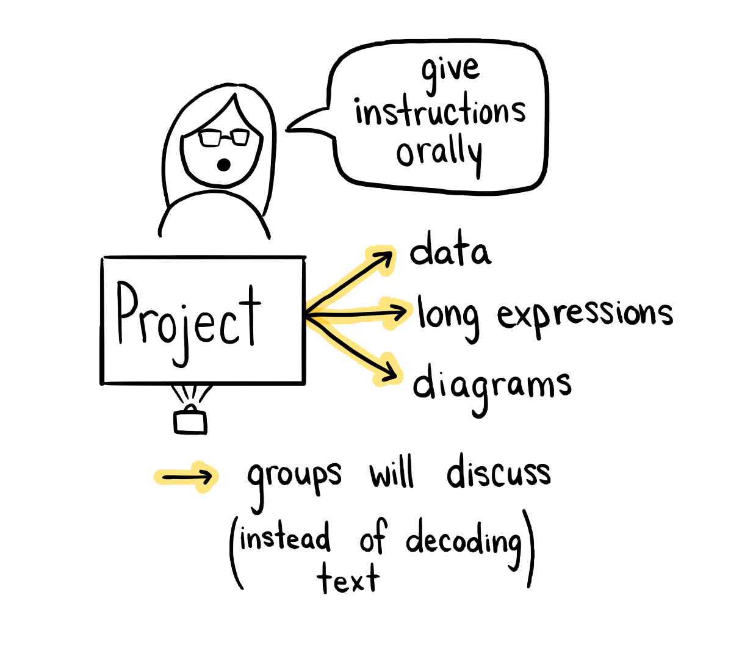
Use Oral
Instructions

Slide 23
How can I
manipulate the traditional
classroom to encourage
engagement in math?
How can I
Stimulate deep
thinking?
WHY VERTICAL
NON-PERMANENT
SURFACES?
Building
Thinking
Classrooms
Use Vertical
Non-Permanent
Surfaces
Form
Visibly
Random
Groups
Begin
with Good
Problems
De-front the
Classroom
Use Oral
Instructions
Answer only
“Keep Thinking”
Questions
Use
Mindful
Notes
Build
Autonomy
Use
Hints and
Extensions
Check for
Understanding
Level
to the
Bottom
Shift
Assessment
Problems
Worth
Solving

Slide 24
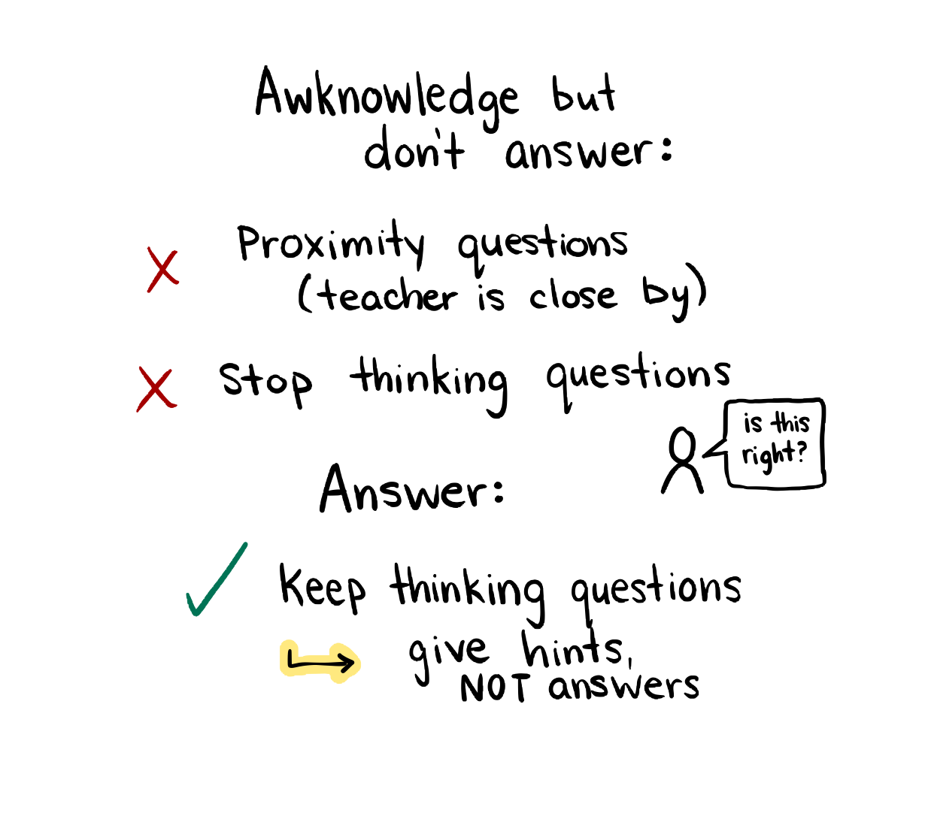
Answer
only
“Keep Thinking” Questions

Slide 25
How can I
manipulate the traditional
classroom to encourage
engagement in math?
How can I
Stimulate deep
thinking?
WHY VERTICAL
NON-PERMANENT
SURFACES?
Building
Thinking
Classrooms
Use Vertical
Non-Permanent
Surfaces
Form
Visibly
Random
Groups
Begin
with Good
Problems
De-front the
Classroom
Use Oral
Instructions
Answer only
“Keep Thinking”
Questions
Use
Mindful
Notes
Build
Autonomy
Use
Hints and
Extensions
Check for
Understanding
Level
to the
Bottom
Shift
Assessment
Problems
Worth
Solving

Slide 26
Build
Autonomy

Slide 27
How can I
manipulate the traditional
classroom to encourage
engagement in math?
How can I
Stimulate deep
thinking?
WHY VERTICAL
NON-PERMANENT
SURFACES?
Building
Thinking
Classrooms
Use Vertical
Non-Permanent
Surfaces
Form
Visibly
Random
Groups
Begin
with Good
Problems
De-front the
Classroom
Use Oral
Instructions
Answer only
“Keep Thinking”
Questions
Use
Mindful
Notes
Build
Autonomy
Use
Hints and
Extensions
Check for
Understanding
Level
to the
Bottom
Shift
Assessment
Problems
Worth
Solving

Slide 28
Use
Mindful
Notes

Slide 29
How can I
manipulate the traditional
classroom to encourage
engagement in math?
How can I
Stimulate deep
thinking?
WHY VERTICAL
NON-PERMANENT
SURFACES?
Building
Thinking
Classrooms
Use Vertical
Non-Permanent
Surfaces
Form
Visibly
Random
Groups
Begin
with Good
Problems
De-front the
Classroom
Use Oral
Instructions
Answer only
“Keep Thinking”
Questions
Use
Mindful
Notes
Build
Autonomy
Use
Hints and
Extensions
Check for
Understanding
Level
to the
Bottom
Shift
Assessment
Problems
Worth
Solving

Slide 30
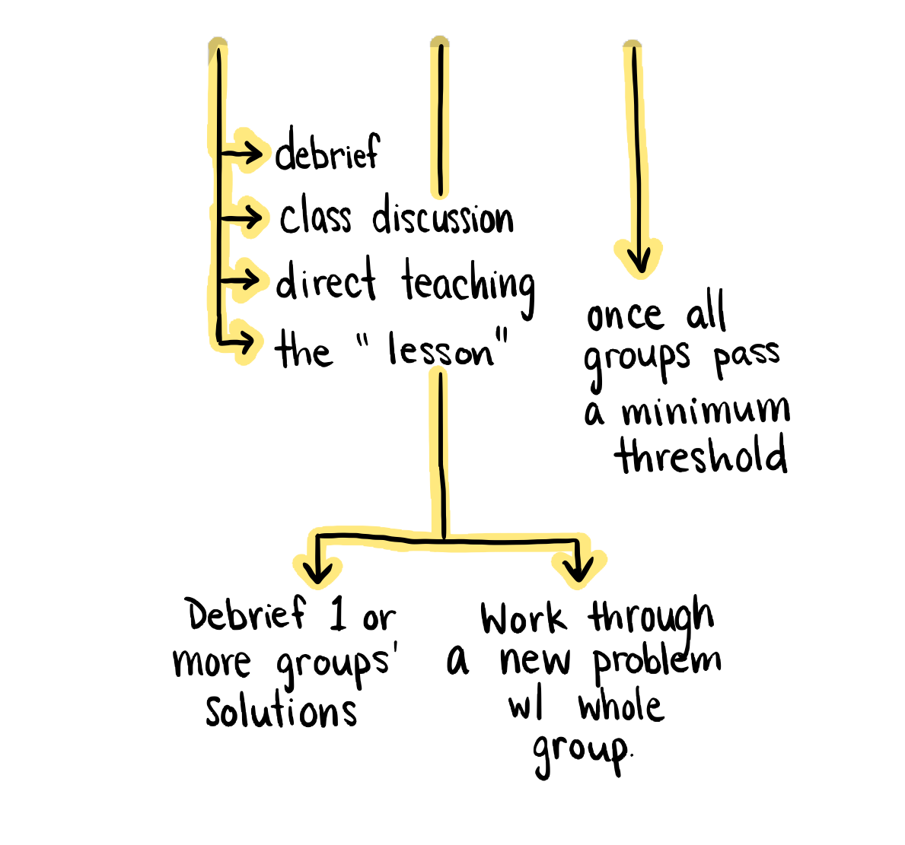
Level
to the
Bottom

Slide 31
How can I
manipulate the traditional
classroom to encourage
engagement in math?
How can I
Stimulate deep
thinking?
WHY VERTICAL
NON-PERMANENT
SURFACES?
Building
Thinking
Classrooms
Use Vertical
Non-Permanent
Surfaces
Form
Visibly
Random
Groups
Begin
with Good
Problems
De-front the
Classroom
Use Oral
Instructions
Answer only
“Keep Thinking”
Questions
Use
Mindful
Notes
Build
Autonomy
Use
Hints and
Extensions
Check for
Understanding
Level
to the
Bottom
Shift
Assessment
Problems
Worth
Solving

Slide 32
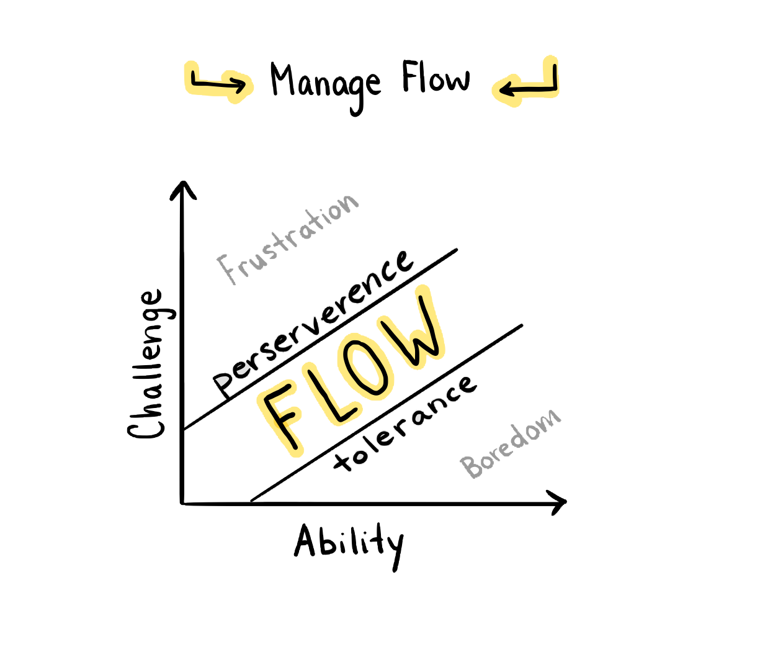
Use
Hints and
Extensions

Slide 33
How can I
manipulate the traditional
classroom to encourage
engagement in math?
How can I
Stimulate deep
thinking?
WHY VERTICAL
NON-PERMANENT
SURFACES?
Building
Thinking
Classrooms
Use Vertical
Non-Permanent
Surfaces
Form
Visibly
Random
Groups
Begin
with Good
Problems
De-front the
Classroom
Use Oral
Instructions
Answer only
“Keep Thinking”
Questions
Use
Mindful
Notes
Build
Autonomy
Use
Hints and
Extensions
Check for
Understanding
Level
to the
Bottom
Shift
Assessment
Problems
Worth
Solving

Slide 34
Shift
Assessment

Slide 35
How can I
manipulate the traditional
classroom to encourage
engagement in math?
How can I
Stimulate deep
thinking?
WHY VERTICAL
NON-PERMANENT
SURFACES?
Building
Thinking
Classrooms
Use Vertical
Non-Permanent
Surfaces
Form
Visibly
Random
Groups
Begin
with Good
Problems
De-front the
Classroom
Use Oral
Instructions
Answer only
“Keep Thinking”
Questions
Use
Mindful
Notes
Build
Autonomy
Use
Hints and
Extensions
Check for
Understanding
Level
to the
Bottom
Shift
Assessment
Problems
Worth
Solving

Slide 36
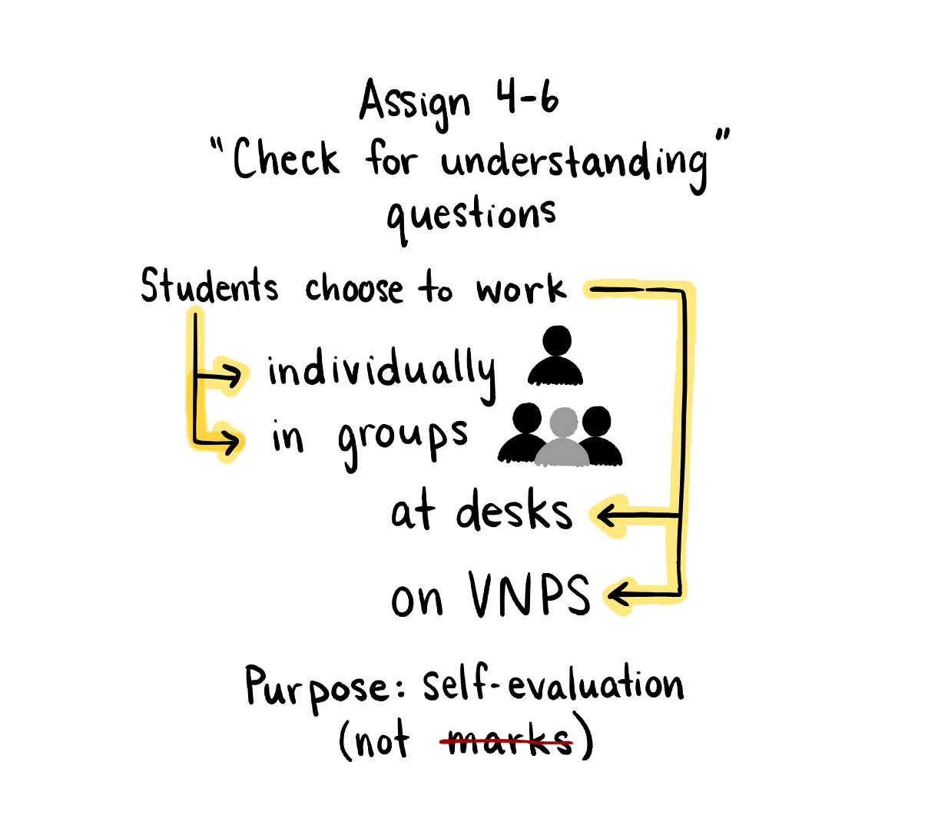
Check for Understanding

Slide 37
How can I
manipulate the traditional
classroom to encourage
engagement in math?
How can I
Stimulate deep
thinking?
WHY VERTICAL
NON-PERMANENT
SURFACES?
Building
Thinking
Classrooms
Use Vertical
Non-Permanent
Surfaces
Form
Visibly
Random
Groups
Begin
with Good
Problems
De-front the
Classroom
Use Oral
Instructions
Answer only
“Keep Thinking”
Questions
Use
Mindful
Notes
Build
Autonomy
Use
Hints and
Extensions
Check for
Understanding
Level
to the
Bottom
Shift
Assessment
Problems
Worth
Solving

Slide 38
Subjective measure, 0-3, of how eager a group was to start working on a task.
0 → No enthusiasm to begin
3 → Every member of the group was wanting to start

Slide 39
How can I
manipulate the traditional
classroom to encourage
engagement in math?
How can I
Stimulate deep
thinking?
WHY VERTICAL
NON-PERMANENT
SURFACES?
Building
Thinking
Classrooms
Use Vertical
Non-Permanent
Surfaces
Form
Visibly
Random
Groups
Begin
with Good
Problems
De-front the
Classroom
Use Oral
Instructions
Answer only
“Keep Thinking”
Questions
Use
Mindful
Notes
Build
Autonomy
Use
Hints and
Extensions
Check for
Understanding
Level
to the
Bottom
Shift
Assessment
Problems
Worth
Solving

Slide 40
Objective measure of how much time passed between the task being given and the when first mathematical notation was made on the work surface.

Slide 41
How can I
manipulate the traditional
classroom to encourage
engagement in math?
How can I
Stimulate deep
thinking?
WHY VERTICAL
NON-PERMANENT
SURFACES?
Building
Thinking
Classrooms
Use Vertical
Non-Permanent
Surfaces
Form
Visibly
Random
Groups
Begin
with Good
Problems
De-front the
Classroom
Use Oral
Instructions
Answer only
“Keep Thinking”
Questions
Use
Mindful
Notes
Build
Autonomy
Use
Hints and
Extensions
Check for
Understanding
Level
to the
Bottom
Shift
Assessment
Problems
Worth
Solving

Slide 42
Subjective measure, 0-3, of how much group discussion there was while
working on a task.
0 → No discussion
3 → Plenty of discussion involving every member of the group

Slide 43
How can I
manipulate the traditional
classroom to encourage
engagement in math?
How can I
Stimulate deep
thinking?
WHY VERTICAL
NON-PERMANENT
SURFACES?
Building
Thinking
Classrooms
Use Vertical
Non-Permanent
Surfaces
Form
Visibly
Random
Groups
Begin
with Good
Problems
De-front the
Classroom
Use Oral
Instructions
Answer only
“Keep Thinking”
Questions
Use
Mindful
Notes
Build
Autonomy
Use
Hints and
Extensions
Check for
Understanding
Level
to the
Bottom
Shift
Assessment
Problems
Worth
Solving

Slide 44
Subjective measure, 0-3, of how persistent a group was while
working on a task.
0 → Group gave up immediately when a challenge was encountered
3 → Group persisted through multiple challenges

Slide 45
How can I
manipulate the traditional
classroom to encourage
engagement in math?
How can I
Stimulate deep
thinking?
WHY VERTICAL
NON-PERMANENT
SURFACES?
Building
Thinking
Classrooms
Use Vertical
Non-Permanent
Surfaces
Form
Visibly
Random
Groups
Begin
with Good
Problems
De-front the
Classroom
Use Oral
Instructions
Answer only
“Keep Thinking”
Questions
Use
Mindful
Notes
Build
Autonomy
Use
Hints and
Extensions
Check for
Understanding
Level
to the
Bottom
Shift
Assessment
Problems
Worth
Solving

Slide 46
Subjective measure, 0-3, of how much participation there was from group
members when working on a task,
0 → No members of the group were actively working on the task
3 → All members of the group were participating in the work

Slide 47
How can I
manipulate the traditional
classroom to encourage
engagement in math?
How can I
Stimulate deep
thinking?
WHY VERTICAL
NON-PERMANENT
SURFACES?
Building
Thinking
Classrooms
Use Vertical
Non-Permanent
Surfaces
Form
Visibly
Random
Groups
Begin
with Good
Problems
De-front the
Classroom
Use Oral
Instructions
Answer only
“Keep Thinking”
Questions
Use
Mindful
Notes
Build
Autonomy
Use
Hints and
Extensions
Check for
Understanding
Level
to the
Bottom
Shift
Assessment
Problems
Worth
Solving

Slide 48
Subjective measure, 0-3, of how non-linear groups were.
0 → Work was orderly and linear
3 → Work was “all over the place”

Slide 49
How can I
manipulate the traditional
classroom to encourage
engagement in math?
How can I
Stimulate deep
thinking?
WHY VERTICAL
NON-PERMANENT
SURFACES?
Building
Thinking
Classrooms
Use Vertical
Non-Permanent
Surfaces
Form
Visibly
Random
Groups
Begin
with Good
Problems
De-front the
Classroom
Use Oral
Instructions
Answer only
“Keep Thinking”
Questions
Use
Mindful
Notes
Build
Autonomy
Use
Hints and
Extensions
Check for
Understanding
Level
to the
Bottom
Shift
Assessment
Problems
Worth
Solving

Slide 50
Subjective measure, 0-3, of how much interaction there was between groups.
0 → No interaction with another group
3 → Lots of on-task interaction with other groups

Slide 51
How can I
manipulate the traditional
classroom to encourage
engagement in math?
How can I
Stimulate deep
thinking?
WHY VERTICAL
NON-PERMANENT
SURFACES?
Building
Thinking
Classrooms
Use Vertical
Non-Permanent
Surfaces
Form
Visibly
Random
Groups
Begin
with Good
Problems
De-front the
Classroom
Use Oral
Instructions
Answer only
“Keep Thinking”
Questions
Use
Mindful
Notes
Build
Autonomy
Use
Hints and
Extensions
Check for
Understanding
Level
to the
Bottom
Shift
Assessment
Problems
Worth
Solving

Slide 52
WHY VERTICAL NON-PERMANENT SURFACES?
Students, in groups of two to four, worked on one of five assigned work surface:
wall mounted whiteboard,
whiteboard laying on top of their desks or table,
flip-chart paper taped to the wall,
flip-chart paper laying on top of their desk or table, and
their own notebooks at their desks or table.
To increase the likelihood that they would work as a group, each groups was provided with only one felt or, in the case of working in a notebook, one pen. To measure the effectiveness of each of these surfaces a series of proxies for engagement were established.
The provided bar graphs demonstrate the collected data.

Slide 53
How can I
manipulate the traditional
classroom to encourage
engagement in math?
How can I
Stimulate deep
thinking?
WHY VERTICAL
NON-PERMANENT
SURFACES?
Building
Thinking
Classrooms
Use Vertical
Non-Permanent
Surfaces
Form
Visibly
Random
Groups
Begin
with Good
Problems
De-front the
Classroom
Use Oral
Instructions
Answer only
“Keep Thinking”
Questions
Use
Mindful
Notes
Build
Autonomy
Use
Hints and
Extensions
Check for
Understanding
Level
to the
Bottom
Shift
Assessment
Problems
Worth
Solving

Slide 54
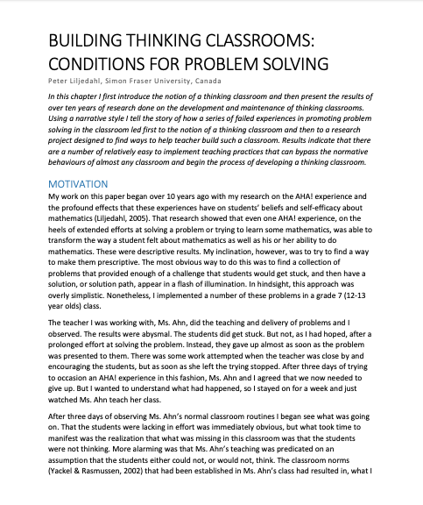
Building Thinking Classrooms:
Conditions for Problem Solving
- Peter Liljedahl, Simon Fraser University
Liljedahl, P. (2016). Building thinking classrooms: Conditions for problem solving. In P. Felmer, J. Kilpatrick,
& E. Pekhonen (eds.) Posing and Solving Mathematical Problems: Advances and New Perspectives. New York,
NY: Springer. [ResearchGate, Academia]

Slide 55
How can I
manipulate the traditional
classroom to encourage
engagement in math?
How can I
Stimulate deep
thinking?
WHY VERTICAL
NON-PERMANENT
SURFACES?
Building
Thinking
Classrooms
Use Vertical
Non-Permanent
Surfaces
Form
Visibly
Random
Groups
Begin
with Good
Problems
De-front the
Classroom
Use Oral
Instructions
Answer only
“Keep Thinking”
Questions
Use
Mindful
Notes
Build
Autonomy
Use
Hints and
Extensions
Check for
Understanding
Level
to the
Bottom
Shift
Assessment
Problems
Worth
Solving

Slide 56
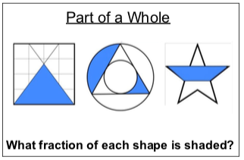
Examples of Problems Worth Solving

Slide 57
How can I
manipulate the traditional
classroom to encourage
engagement in math?
How can I
Stimulate deep
thinking?
WHY VERTICAL
NON-PERMANENT
SURFACES?
Building
Thinking
Classrooms
Use Vertical
Non-Permanent
Surfaces
Form
Visibly
Random
Groups
Begin
with Good
Problems
De-front the
Classroom
Use Oral
Instructions
Answer only
“Keep Thinking”
Questions
Use
Mindful
Notes
Build
Autonomy
Use
Hints and
Extensions
Check for
Understanding
Level
to the
Bottom
Shift
Assessment
Problems
Worth
Solving

